Slide 1
VR to teach Empathy
Presented By:
Krishana Gyanwali
Sr. Application Engineer at DTC (Data Science Team, Bank oF America, Plano Texas)
Graduate Student, Computer Science, Texas Tech
“See the light in each other. Be the light for each other.” :-Anonymous
“If you judge people, you have no time to love them.” : - Mother Teresa
Please check the link below to know more detail or Open the hyperlink:
https://github.com/kgyanwal/krishana_VR_student_choice/blob/gh-pages/paper_review.md

Slide 2
Introduction
RESEARCH ARTICLE
Building long-term empathy: A large-scale comparison of traditional and virtual reality perspective-taking
Virtual Reality (VR) has given importance not only to the technical simulation of the environment but also to teach users empathy.
The research says that VR as the ‘ultimate empathy machine’, that allows user to unleash their experience from any point of view. Empathy is the ability to understand someone else’s emotions. In a 3D environment, people move freely and interacts with their simulated environment.
Research Subjects: 100, then 1000 Bay area participants

Slide 3

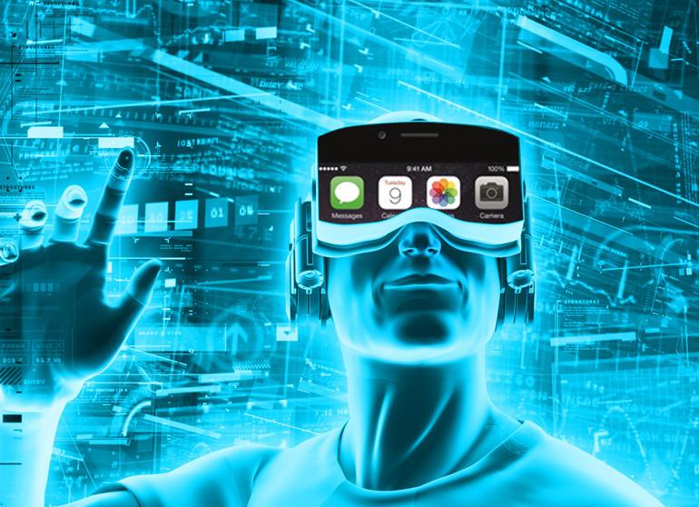



A visual representation of the paper!
Participant’s interaction, response and internalizing the event
Narrative
Virtual Environment
Results shows that it could be Useful to train employees in corporations
Human
A simple machine learning design
This Photo by Unknown Author is licensed under CC BY-SA

Slide 4
Narrative
“The narrative begins with the participants sitting in their apartment after losing their job and realizing rent is due. Despite selling most of their belongings, participants are not able to raise enough money to pay rent and are evicted from their apartment.
Forced to live out of their car, they prepare themselves for the night by trying to find their toothbrush and other items needed to brush their teeth. Participants suddenly hear a police siren and are approached by a police officer who discovers the participants are living out of their car. Due to a city ordinance prohibiting the use of cars as homes in public spaces, the car is impounded.
Participants are now traveling on a bus at night for shelter and warmth, when they are warned that there are two men onboard who may serve as a threat to them. One man may try to get unpleasantly close to the participant while the other may try to steal the participant’s backpack. In the bus, participants also interact with other non-threatening homeless people and learn about their experiences.”

Slide 5
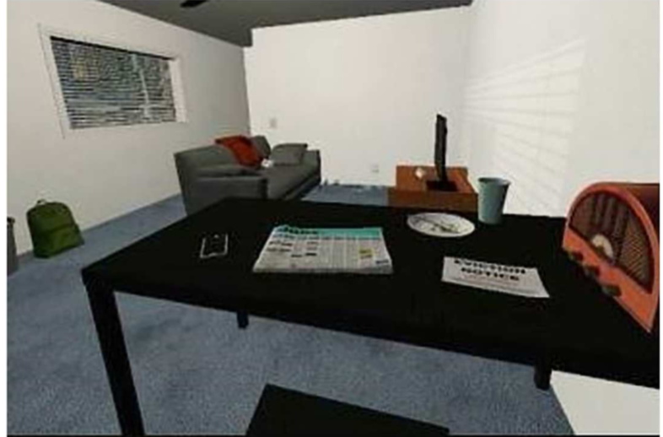
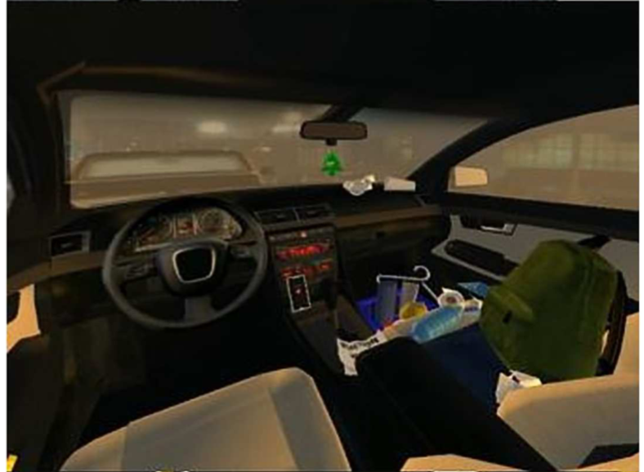
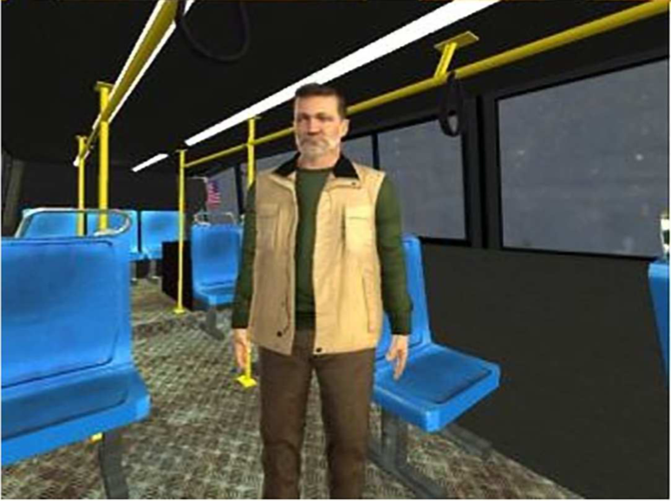
Visual Representation of Narrative: Adopted from the paper
1. Participant’s point of view in the apartment scene.
2. Participant’s point of view in the car scene.
3. Participant’s point of view in the bus scene.

Slide 6
Why VR is good for teaching empathy
Being social
Higher interaction means a higher feeling of presence or feeling on the actual situation (being there) and better engagement with the events with a personalized experience.
Higher cognitive ability has increased interactivity, which shows empathy towards the protagonist.
Analysis
Inclusion of the Other in the self
Empathy
Personal distress
Social Presence Scale
Attitudes towards the homeless
Behavioral measures
Donation questions
Letter Writing

Slide 7
Shortcomings
One time of a person’s opinion does not determine the person beholds the same opinion in the future.
Small Sample size: 100 or 1000 is still a small sample size.
Qualitative phenomena are always challenging to measure in the long run because the human’s feeling is so volatile.
The study is still homogenous because it has captured the feeling of SF bay area people, it is hard to generalize to the larger audience with the same empathy score.

Slide 8
Future Work and Conclusion
Future Work
Since the study is already working to minimize racial issues using VR, it could be useful for many companies to save a lot of money because they have repetitive causes of racial issues and they end up paying a lot of money in the lawsuit. It is because the research has shown the empathy has increased over time.
Conclusion
Though the research shows promising results, it is yet to cover more geographic areas. This research can be expended and utilized by industries especially for the staff training to minimize the enterprise risk. It is also can be useful for social well-being for every individual.

Slide 9

Questions
Questions?

Slide 10




Thank you so much for your kind Attention!!!

